Slide 1


Loan Default Prediction App
Predicting Loan Defaults Using Machine Learning

Slide 2
What Does the Application Do?
Predicts the likelihood of a loan applicant defaulting based on user-inputted features.
Features:
Accepts inputs like credit score, loan amount, income, employment status, debt-to-income ratio, and past defaults.
Provides predictions using an XGBoost model.
Displays a probability score indicating the likelihood of default.
Key Enhancements:
Adjustments for realistic predictions with scaled inputs for past defaults.
Raw probabilities are displayed alongside categorical predictions.

Slide 3

Model Choice
XGBoost
Reasons for Choosing XGBoost:
High predictive power and performance on tabular data.
Built-in handling of missing values and categorical encoding.
Excellent performance in handling imbalanced datasets.
Performance Highlights:
Accuracy: ~84%
AUC-ROC: ~0.94
To further enhance model interpretability, SHAP was used to analyze feature contributions.

Slide 4
Methodology
Problem Framing:
Business Problem: Predict loan defaults to support financial decision-making.
Data Exploration: Cleaned and augmented dataset to ensure consistency with the model.
Feature Engineering:
One-hot encoding for categorical features.
Adjustments for scaling numerical features (e.g., Past Defaults).
Model Training:
Hyperparameter tuning to optimize model performance.
Validation:
Evaluated on test data using metrics like AUC-ROC, F1 Score, and Accuracy.
Deployment:
Application built using Dash to allow user interaction with the model.

Slide 5
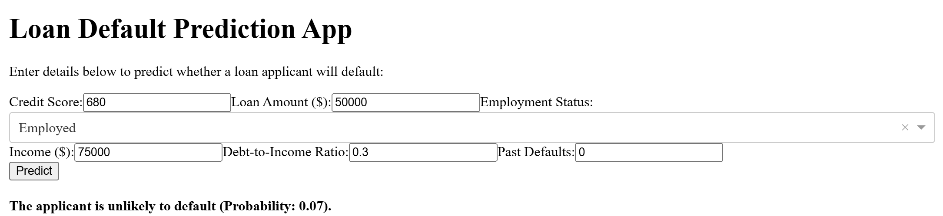
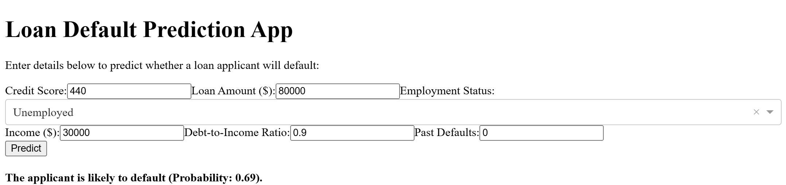
Prediction Example
This image demonstrates the functionality of the Loan Default Prediction App, showcasing an applicant's profile and prediction outcome. The applicant is unlikely to default (Probability: 0.07).
This example shows a loan applicant with different input parameters entered into the Loan Default Prediction App. The applicant is likely to default (Probability: 0.69).

Slide 6
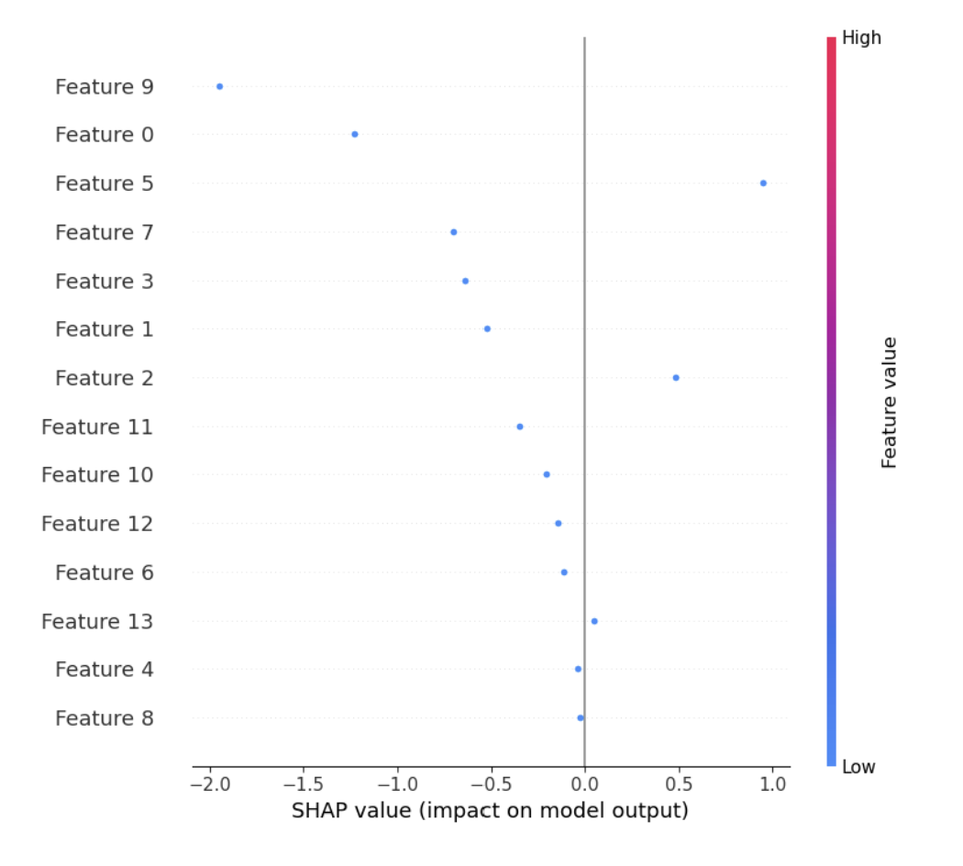
SHAP Plot with Features
8 Employment Status_Unemployed
9 Credit Score Category_Low
10 Credit Score Category_Medium
11 Income Category_Low
12 Income Category_Medium
13 mployment Status_Employed
1 Cert
2 Fund
3 Credit Score
4 Loan Amount
5 Income
6 Debt-to-Income Ratio
7 Employment Status_Self-Employed

Slide 7
Next Steps
Operational Product:
Add a database for storing user inputs and predictions for future analysis.
Implement real-time API integration for live predictions.
Enhanced Interpretability:
Future improvements include retraining the model with new data, refining feature selection, and addressing bias using fairness-aware machine learning techniques.
Scalability:
Deploy the app using cloud platforms like AWS or Azure for broader access.

Slide 8
Lessons Learned & Questions
What I Learned:
Importance of feature scaling and calibration for realistic predictions.
Challenges of aligning input features with model expectations.
Using Dash for interactive model deployment.
Questions I Still Have:
How to optimize scaling adjustments for features like Past Defaults without skewing probabilities?
Best practices for managing imbalanced datasets during model training.

